Slide 1
Desperately Seeking Default
Geoff Huston
APNIC

Slide 2
In the Telephone Network
All telephones were equally reachable
Anyone could dial anyone else

Slide 3
In the Telephone Network
Internet
Are all connected endpoints equally reachable?
Can anyone can reach anyone else?

Slide 4
In the Telephone Network
Internet
Are all connected endpoints are equally reachable?
Can anyone can reach anyone else?
No!

Slide 5
In the Telephone Network
Internet
Are all connected endpoints are equally reachable?
Can anyone can reach anyone else?
No!
NATs and Firewall Filters changed our conception of the Internet from a peer-to-peer network to a limited client/server architecture.
Our current expectations are that if you stand up a public service on port 80 (or 443 for that matter) outside of a NAT, then maybe everyone can reach you, but otherwise, no.

Slide 6
In the Telephone Network
Internet
All connected endpoints are equally reachable
Can anyone can reach anyone else?

Slide 7
In the Telephone Network
Internet
All connected endpoints are equally reachable
Can anyone can reach anyone else?
We might THINK this, but is it true ALL the time?

Slide 8
What do we see?
On the Internet is everyone really connected to everyone else?

Slide 9
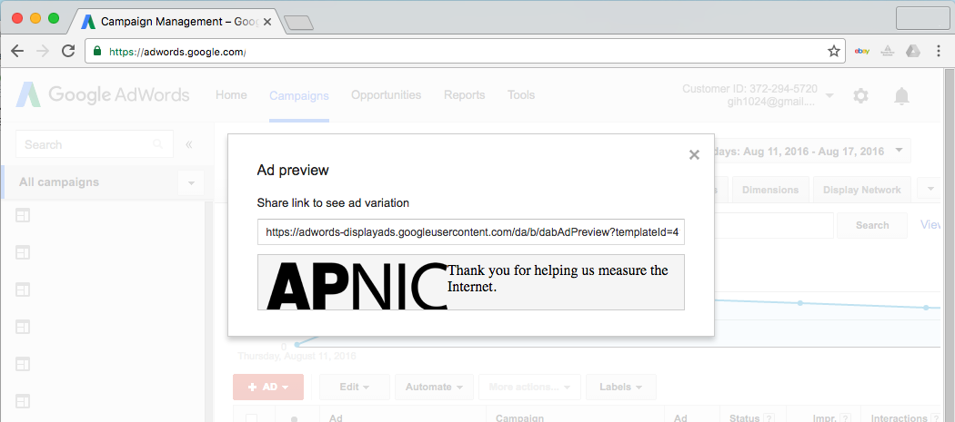
How We See
We use an online ad to present a sequence of small fetches to the user’s browser

Slide 10
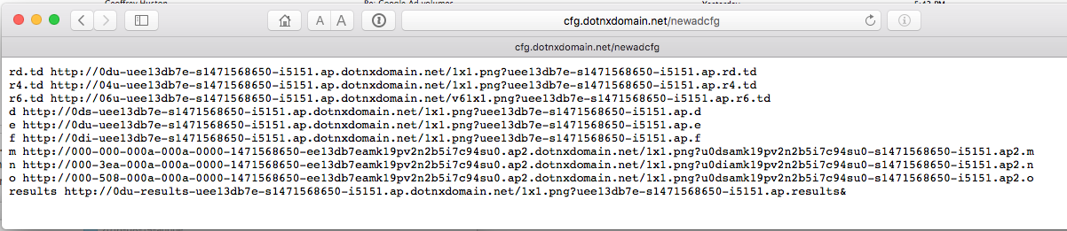
How We See
The sequence of tests is used to test a number of types of actions including fetches of IPv4,
IPv6 and Dual stack

Slide 11
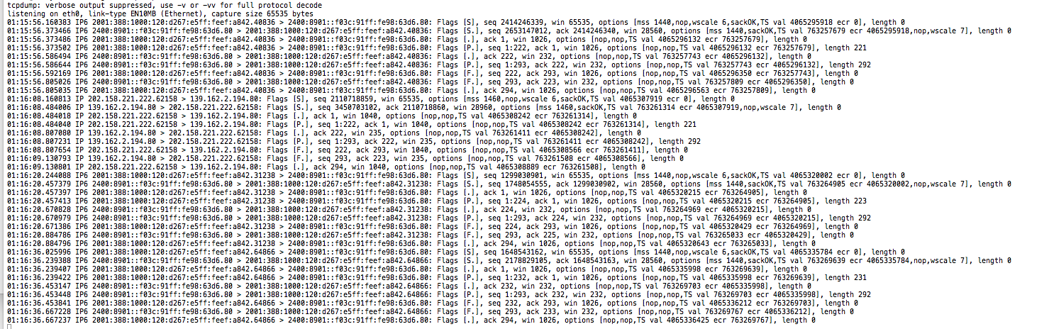
How We See
We use tcpdump to record all packet activity at the experiment’s servers

Slide 12
What we see: Connection Failure
Outbound SYN
client
server
Busted SYN ACK
Return path
What the server sees is an incoming SYN, but no matching incoming ACK

Slide 13
Daily IPv6 Failures
6to4 failure: around 10%
Average IPv6 failure: around 2%
Unicast IPv6 failure: around 1.5%

Slide 14
Daily IPv6 Unicast Address Failures
1.5% failure rate

Slide 15
IPv6 Failures
1.5% failure for unicast V6 is unacceptable!
Why is this happening
  Auto-tunnelling?
  Lousy CPE firmware?
  Strange firewall filters?
But is all of this due to local configuration / equipment?
What is the comparable view in IPv4?

Slide 16
IPv4 Connection Failure
0.2% failure rate

Slide 17
IPv4 Failures
IPv4 failures are around 1 in 500
And we are pretty sure its NOT:
  Auto-tunnelling
  Lousy CPE firmware
  Strange firewall filters
So what is the reason for this residual asymmetric failure rate?
Is it asymmetric routing connectivity?

Slide 18
Route Views Routing Table

Slide 19
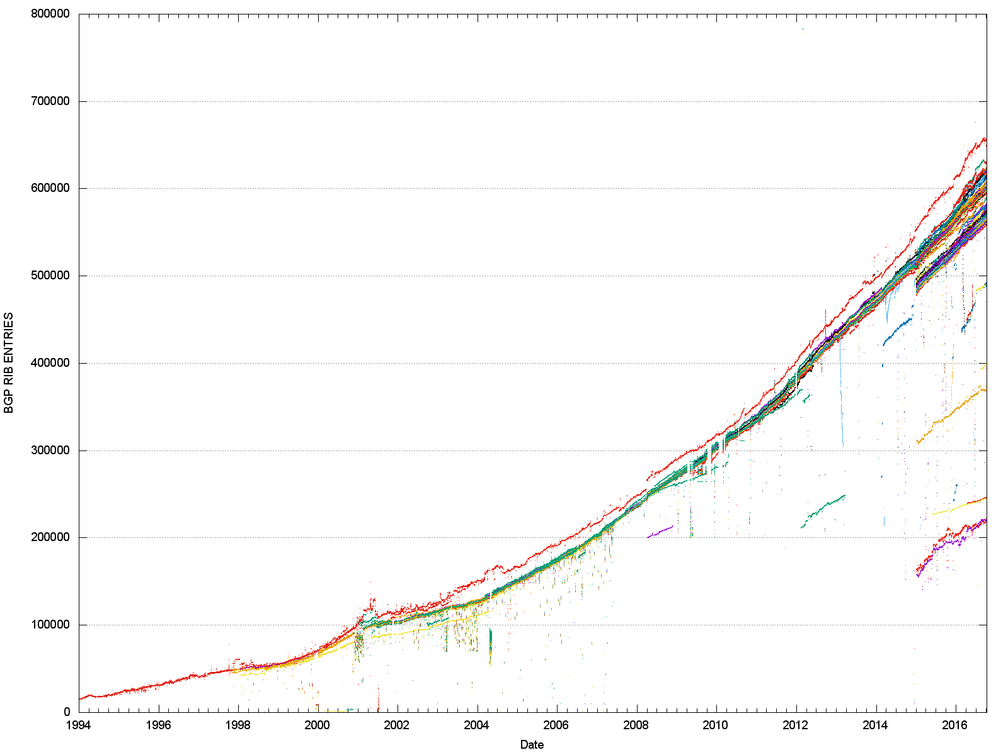
25 Years of Routing the Internet
This is a compound view pulled together from each of the IPv4 routing peers of Route Views and RIS

Slide 20
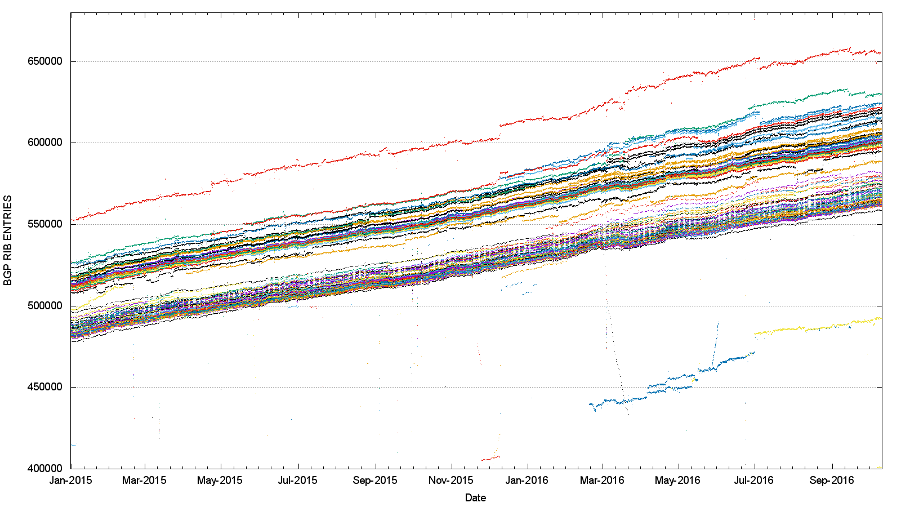
IPv4 - 2015/16 IPv4 Route Views + RIS
This is a view pulled together from each of the routing peers of Route Views and RIS
That’s a range of 100,000 routes!

Slide 21
Different peers see a slightly different Internet
But is this just traffic engineering more specifics?
Or do different peers see a different set of reachable addresses in the routing table?

Slide 22
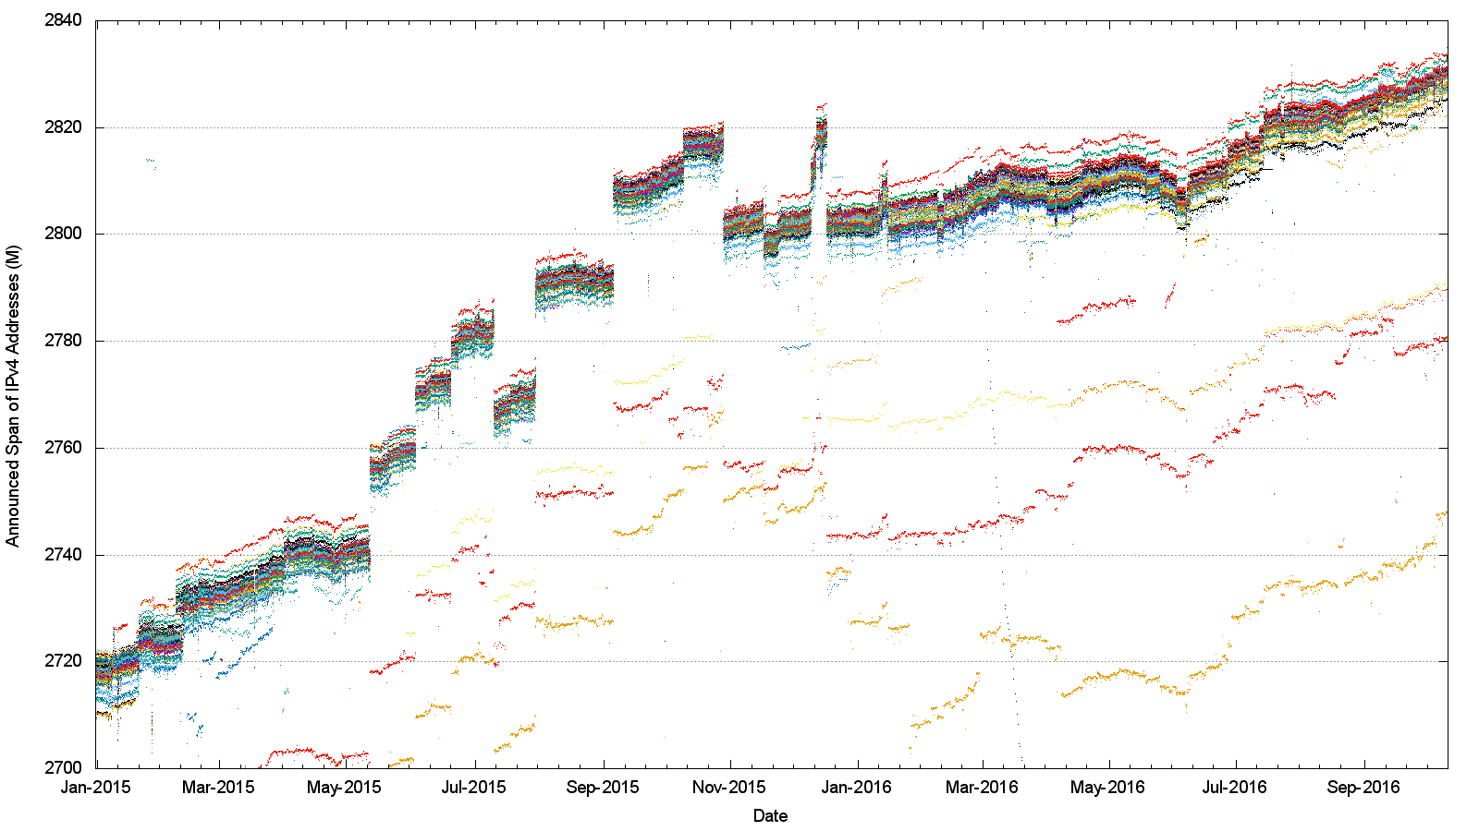
Address Span
(Route Views + RIS data sets)

Slide 23
Address Span
(Route Views + RIS data sets)
15 M Addresses

Slide 24
What does this mean?
Each peer of RouteViews and RIS announces a span of addresses that appears to be a unique span.
In total, these spans agree with other to within ~20M addresses, but this means that there are potentially some 20M uniquely addressed endpoints that cannot be reached from all other endpoints.
This variation is stable over time for each peer, so its not transient routing that is generating this – the reasons for this difference in reachability are structural

Slide 25
What about IPv6?

Slide 26
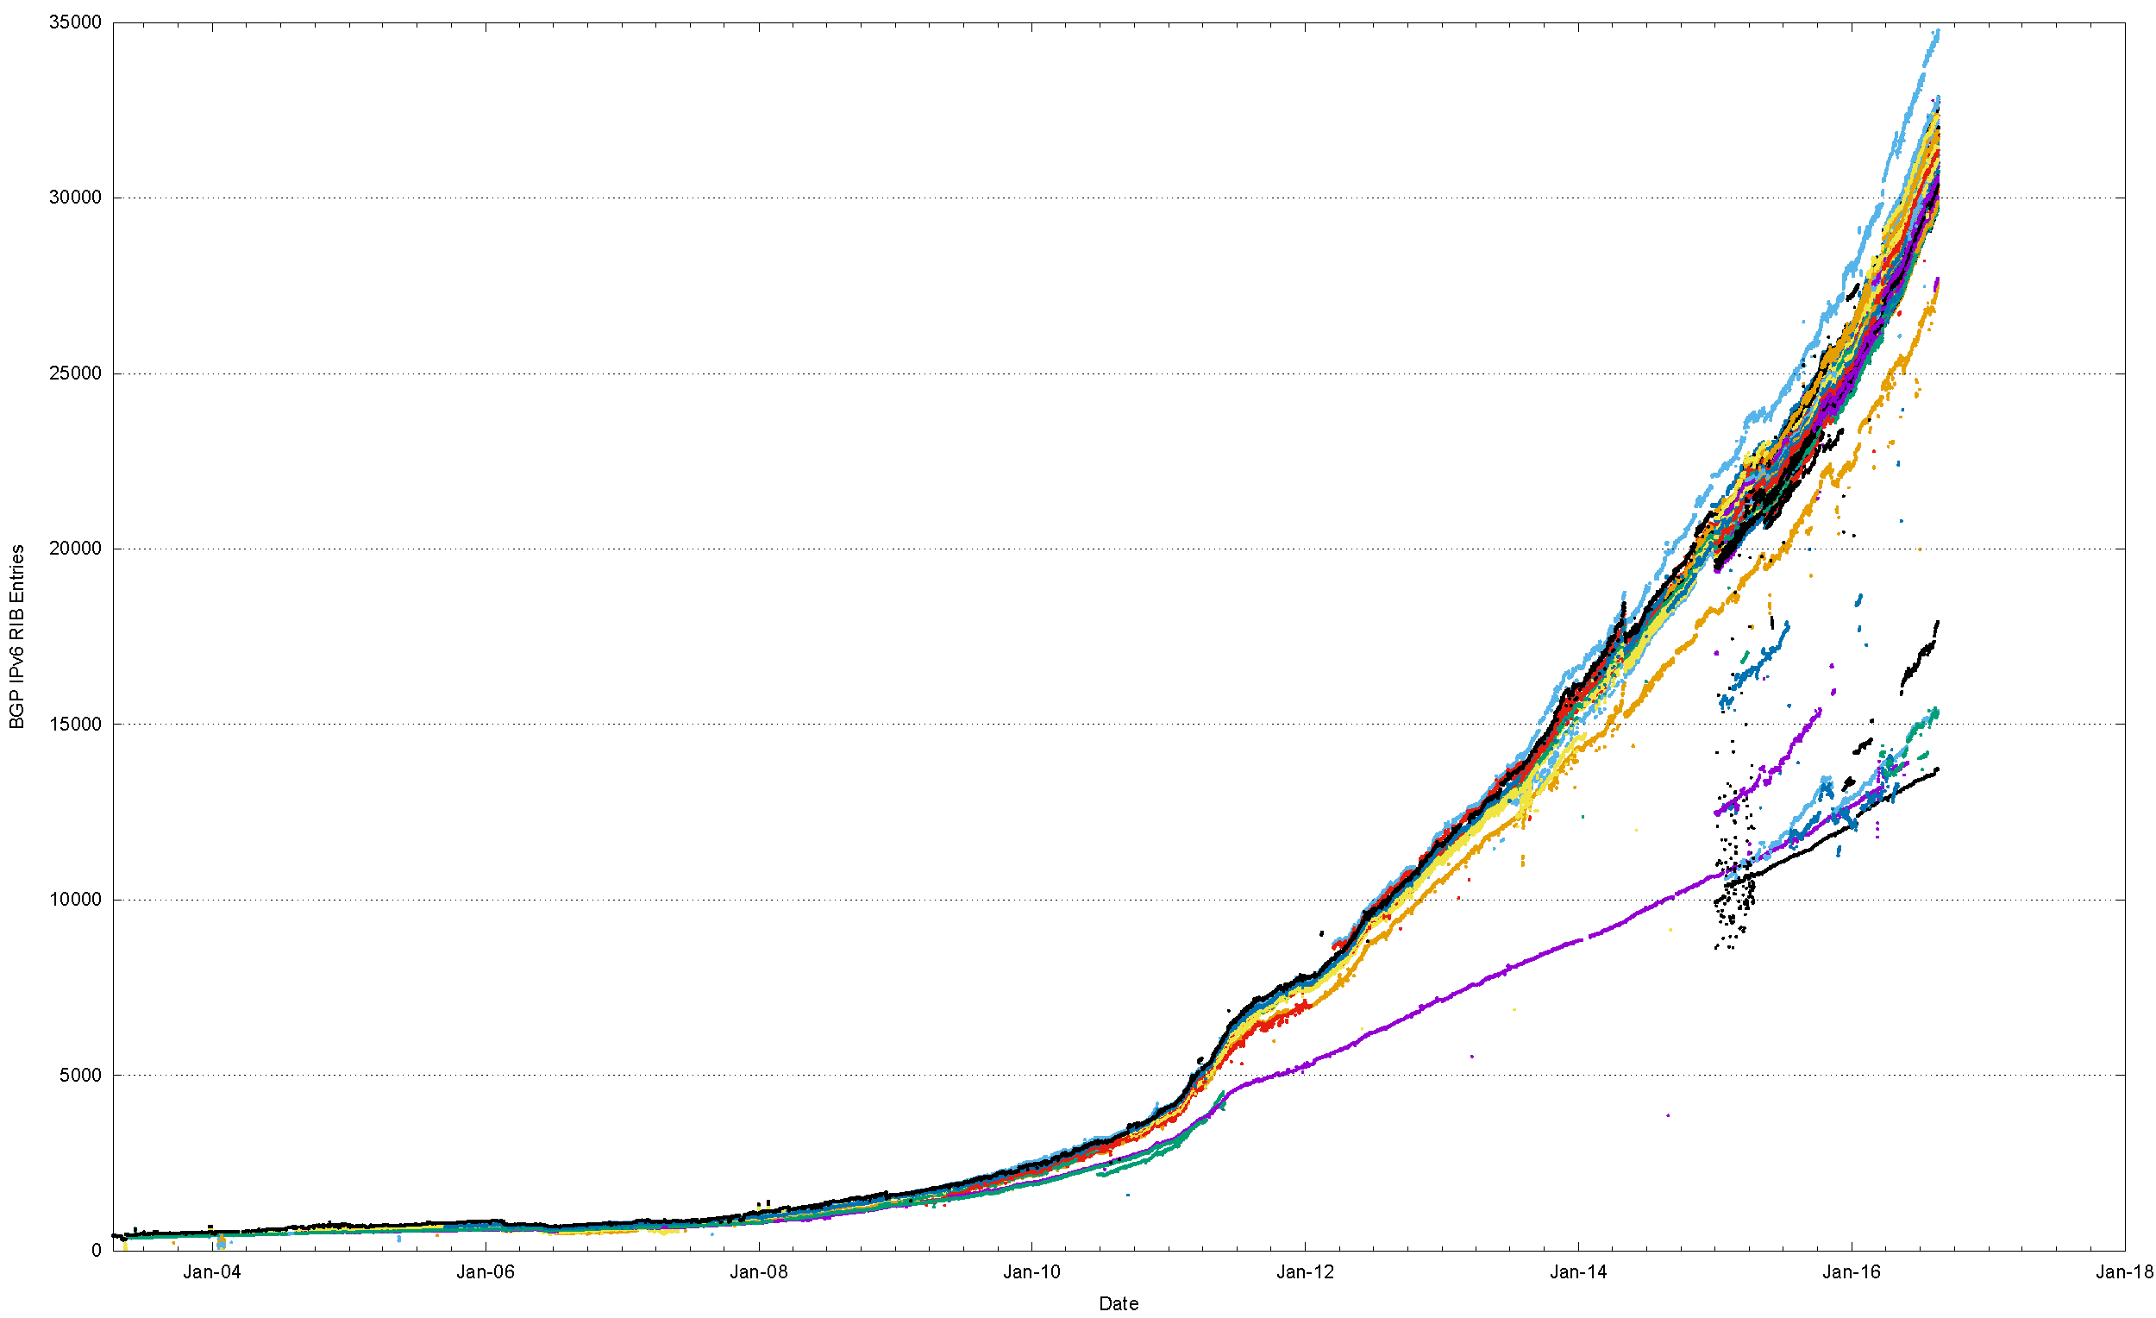
The Route Views view of IPv6
World IPv6 Day
IANA IPv4 Exhaustion

Slide 27
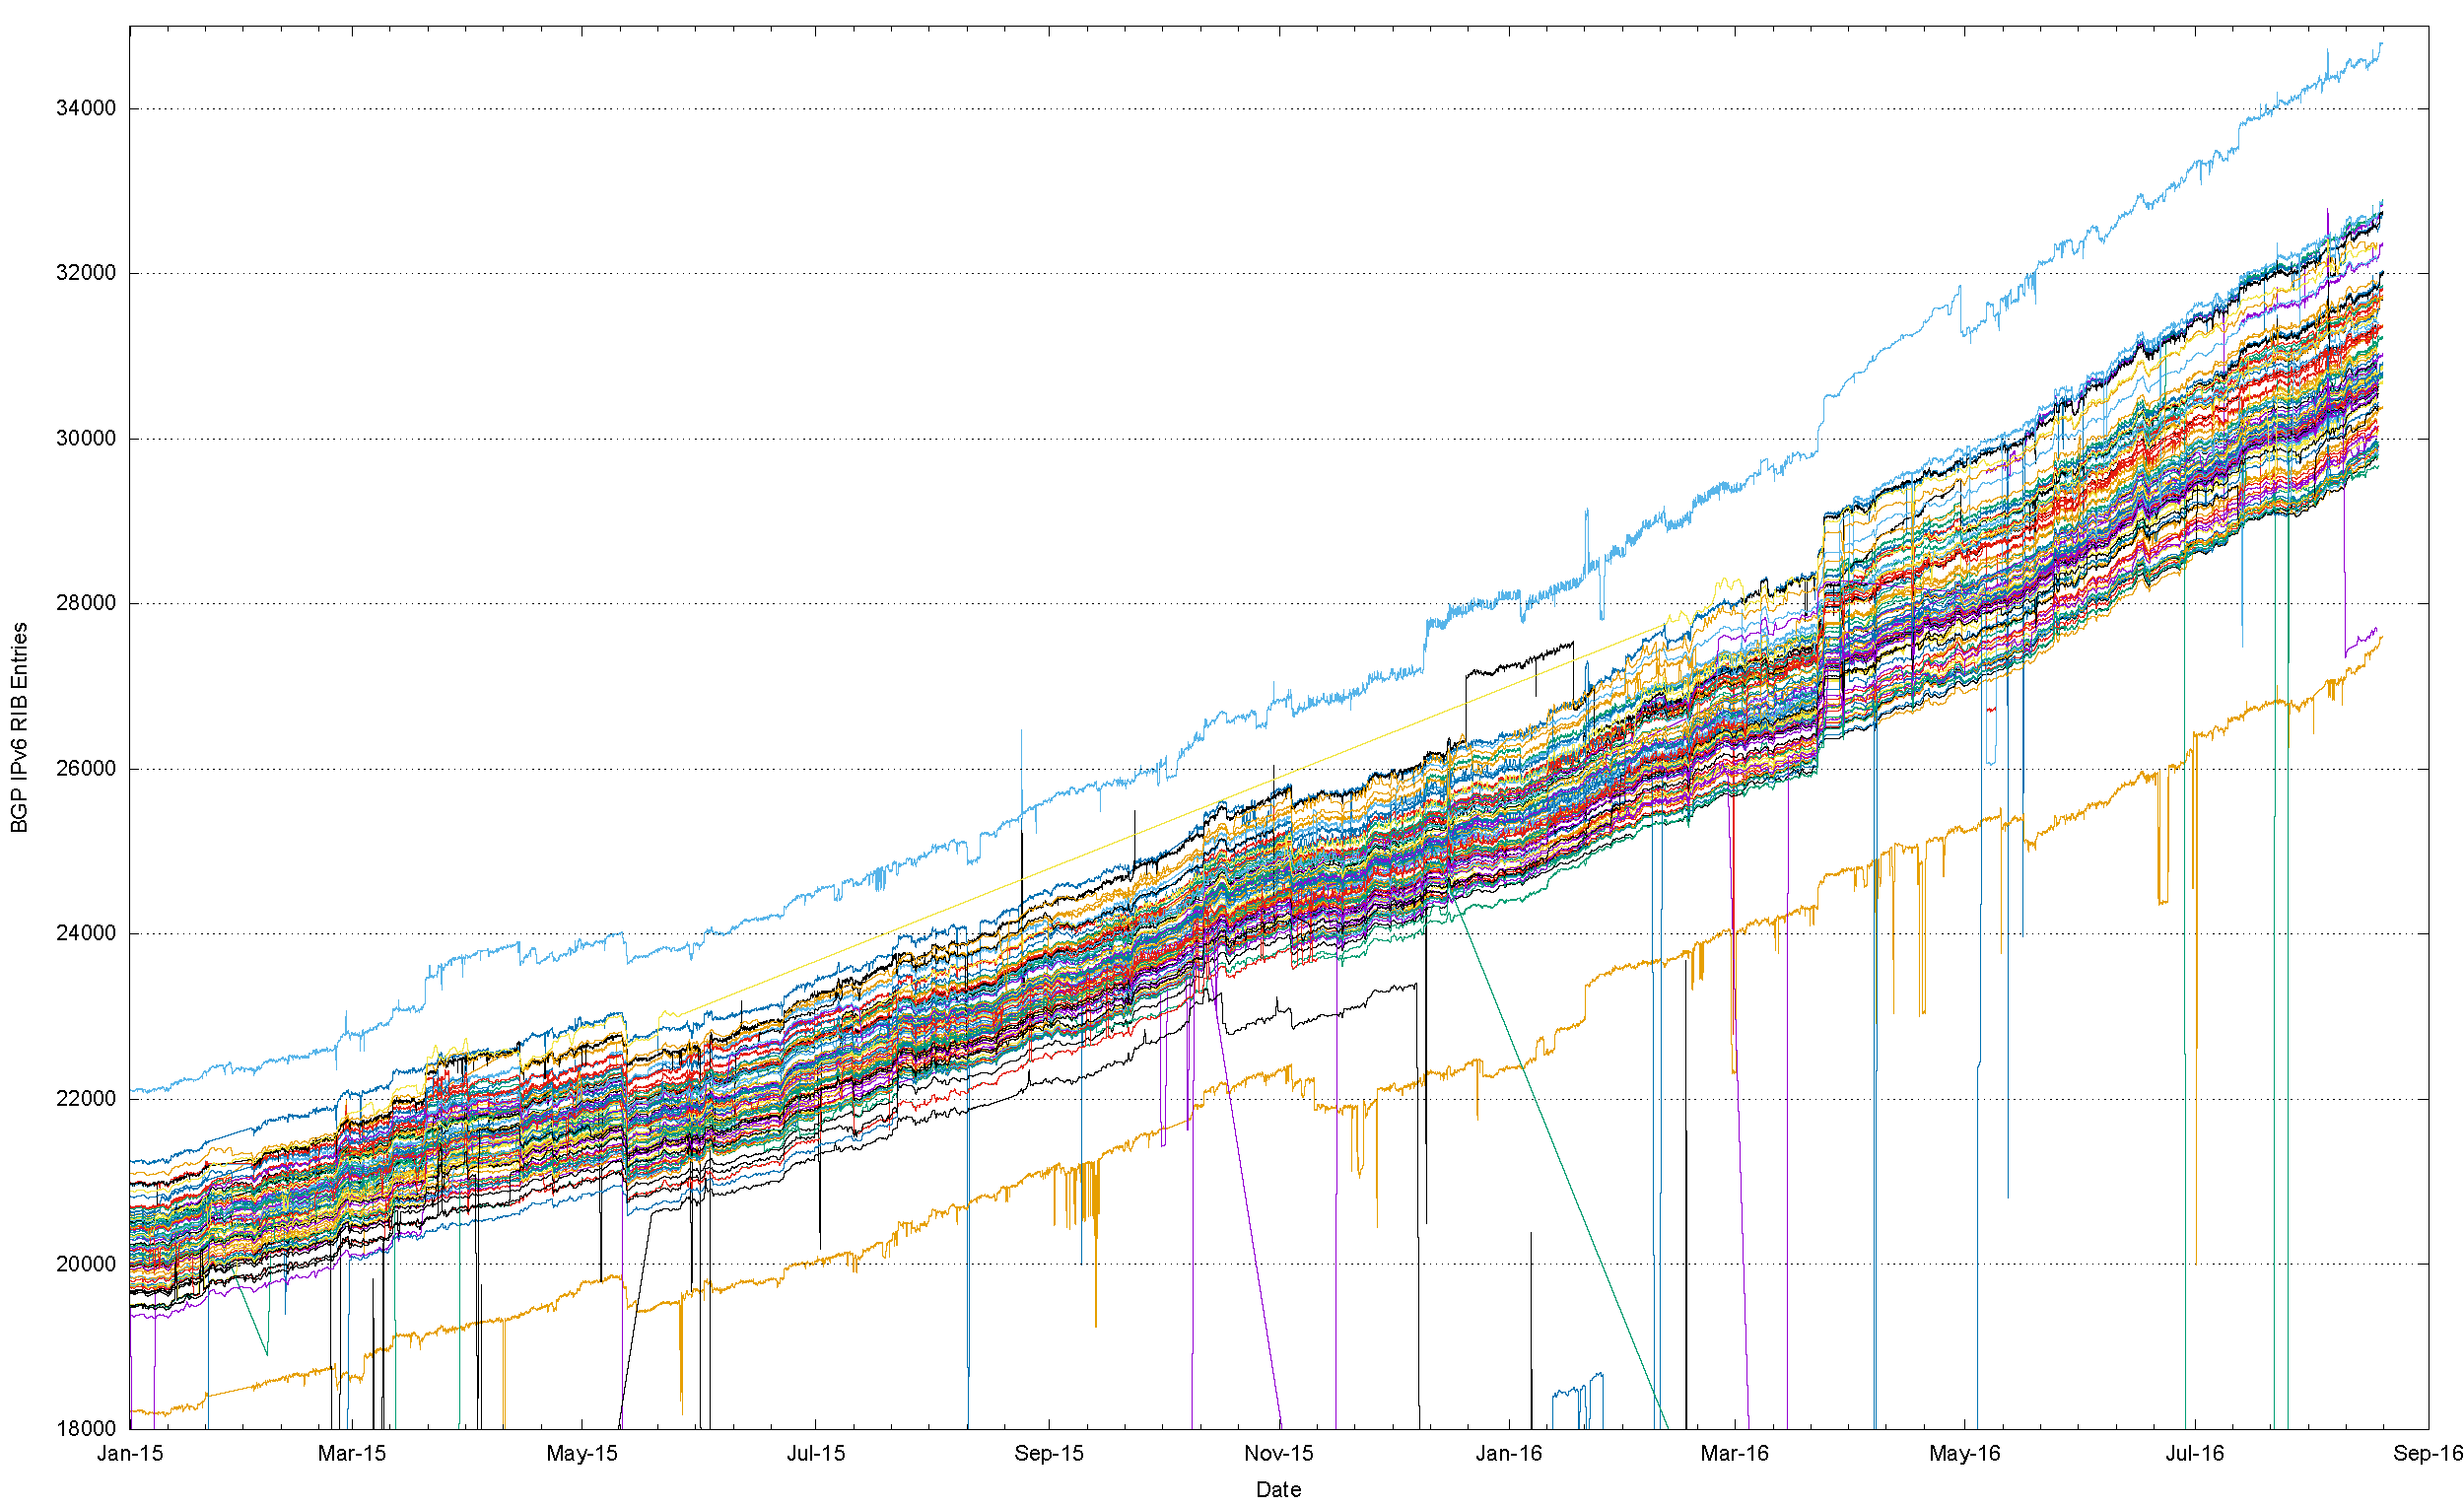
Number of IPv6 Routes in 2015/16
That’s a
range of 2,300
routes!

Slide 28
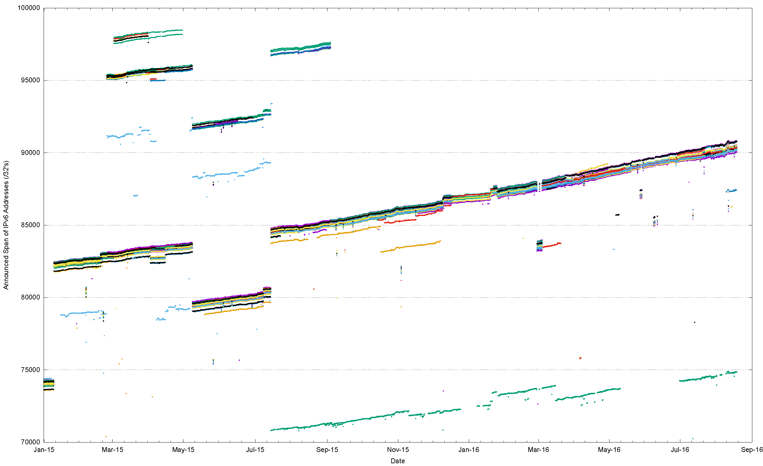
IPv6 Announced Address Span Variation (RV + RIS)

Slide 29
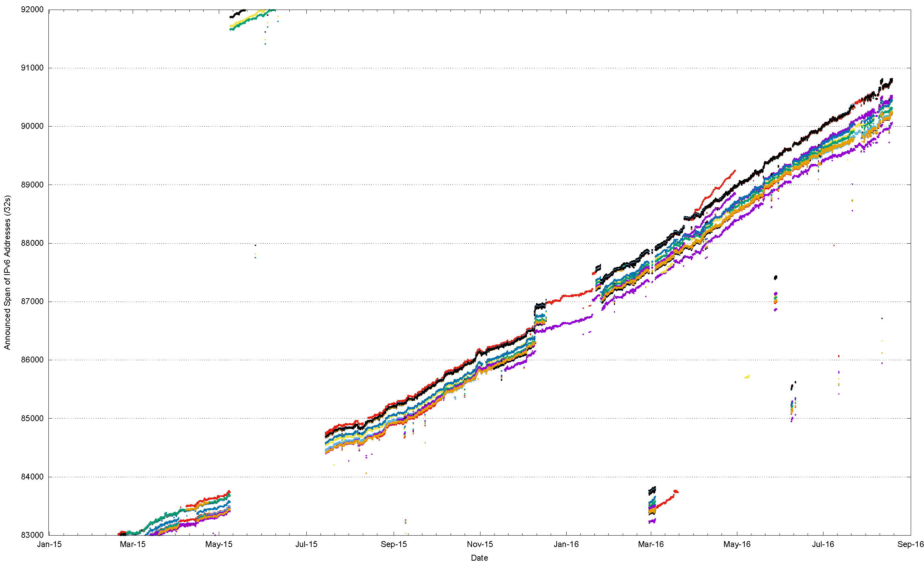
IPv6 Announced Address Span Variation (RV + RIS)

Slide 30
What is “default”?
We don’t know!
There is no “default” route set that we can all agree on

Slide 31
What is “default”?
At best “default” is an informal quorum
  So lets define this quorum by arbitrarily setting the quorum threshold at 2/3
  i.e. if 2/3 of the peers of a route collector advertise a route then it is part of the default quorum.
Individual peer networks will contain route sets that differ from this quorum by having both additional prefixes and holes.
  Lets look at the variance from the quorum

Slide 32
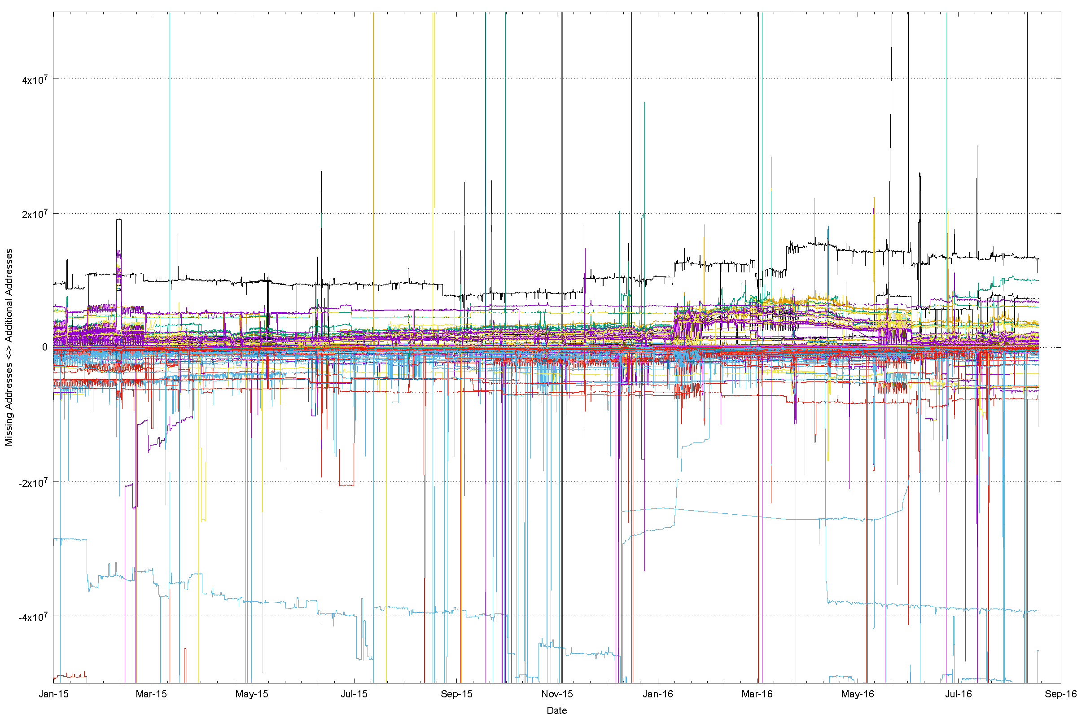
A “Quorum” deviation view of IPv4

Slide 33
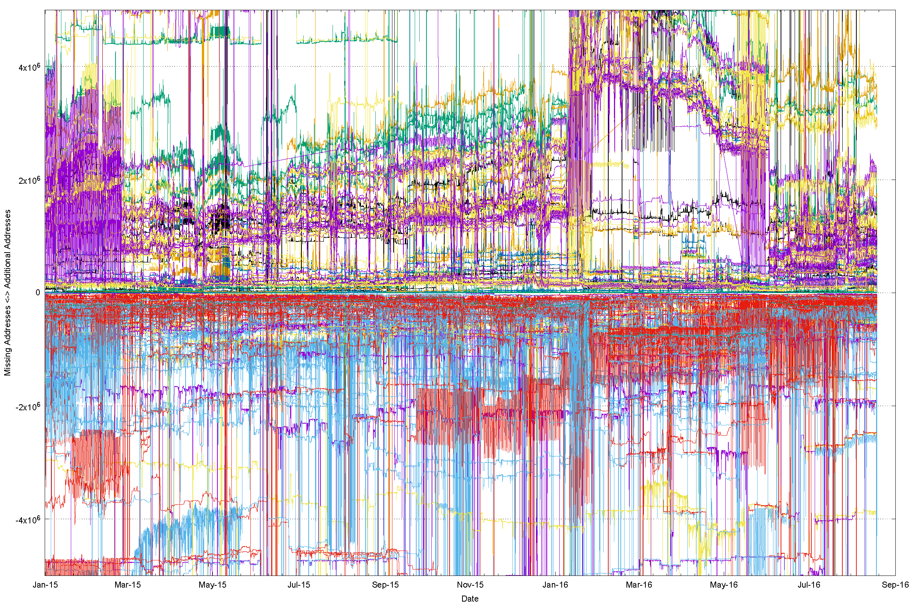
A magnified view

Slide 34
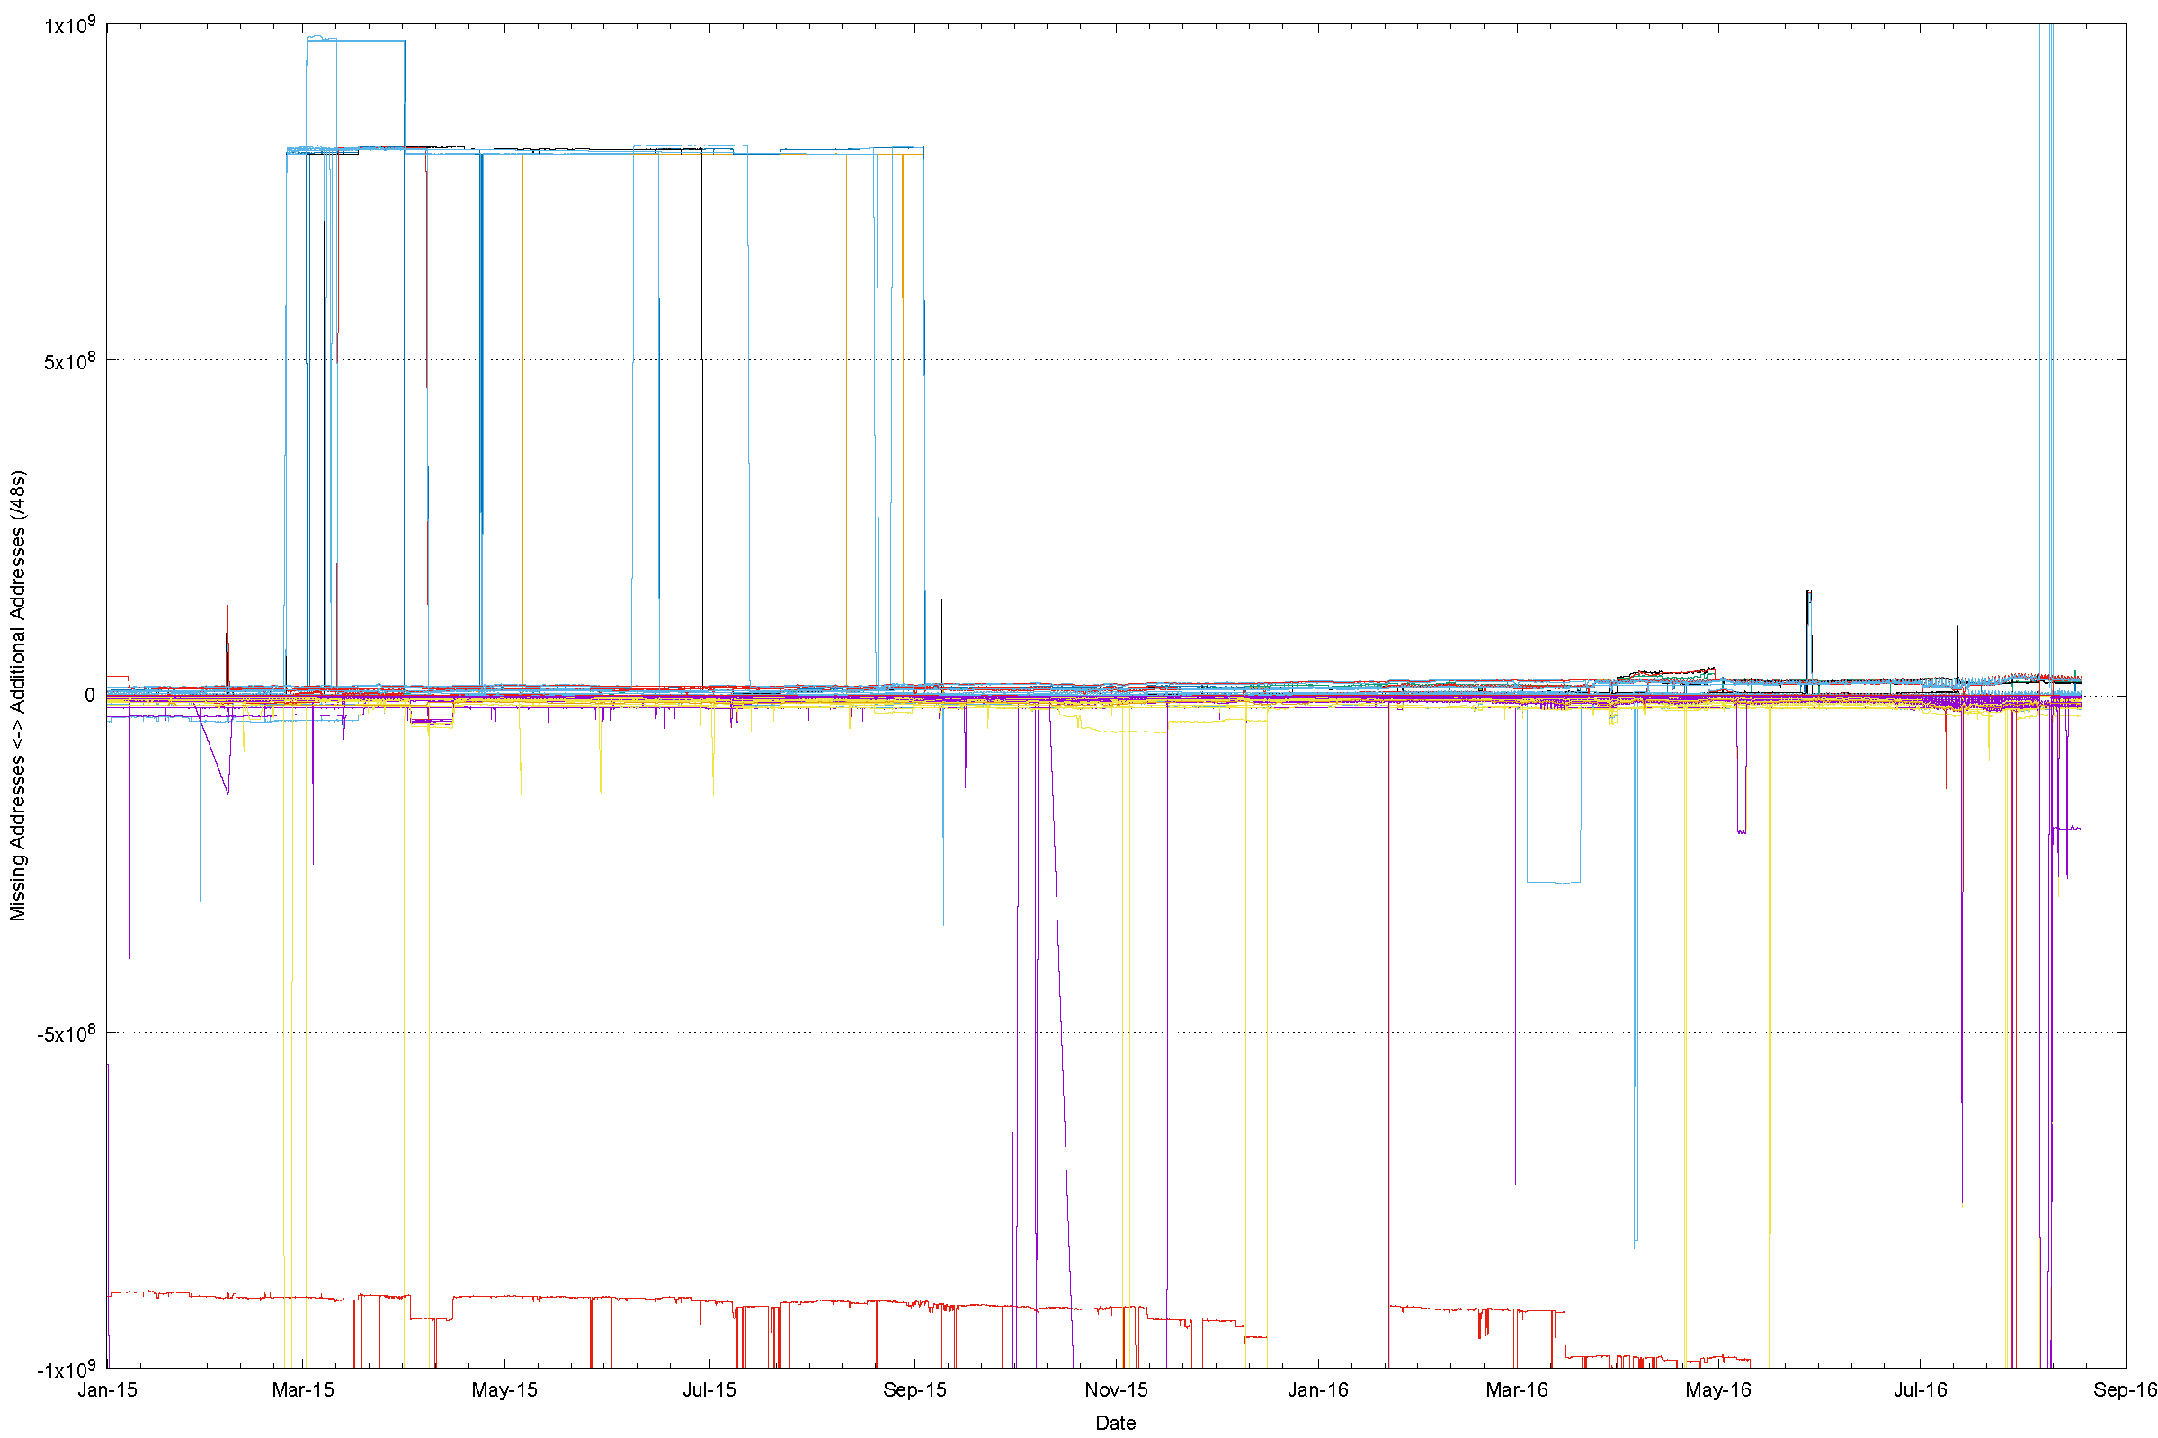
IPv6 “Quorum” Deviation

Slide 35
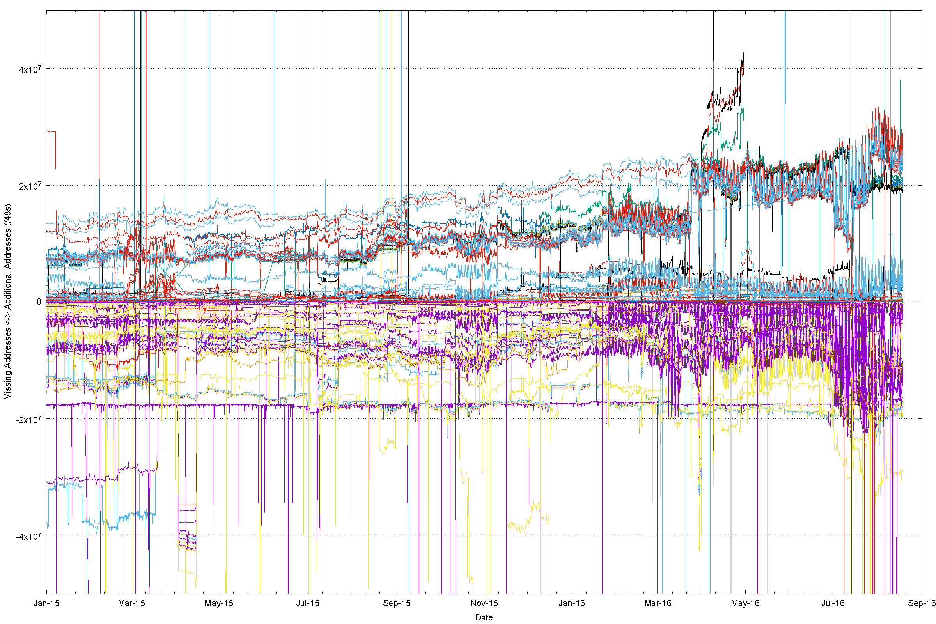
Zooming In

Slide 36
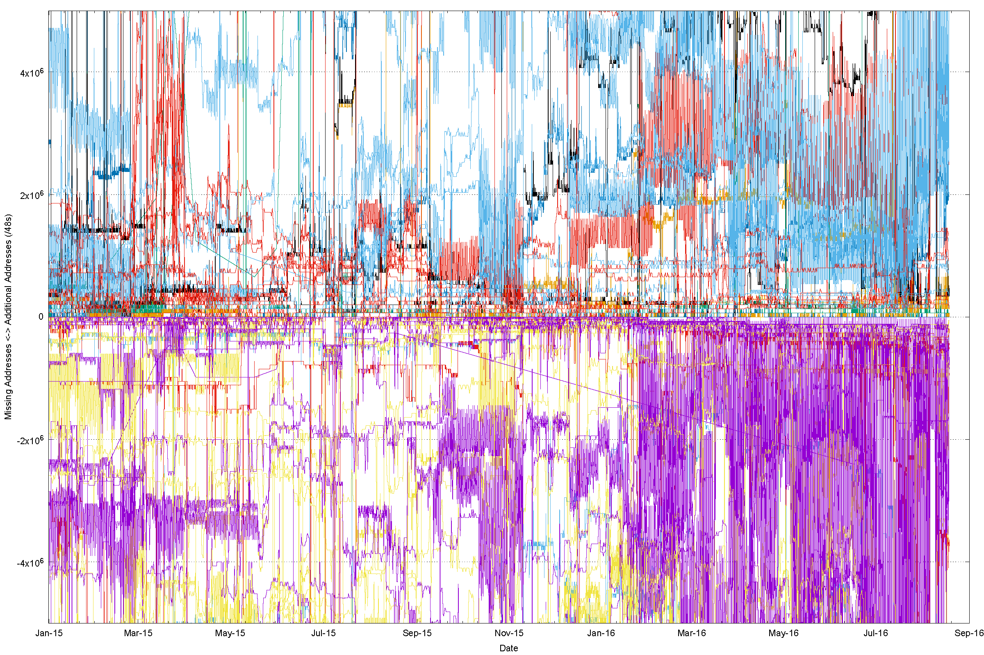
And Again

Slide 37
Quorum Deviation for RVA IPv4 Peers (18th August 2016)

Slide 38
Quorum Deviation for RIS IPv4 Peers

Slide 39
Quorum Deviation: IPv6, RVA

Slide 40
Quorum Deviation: IPv6, RIS

Slide 41
It’s structural, not temporal
There is a visible stability to this deviation from the quorum route set
  The variation from the quorum is long–term stable, and does not rapidly self-correct – its not a transient routing state
We appear to assume that all Tier 1 providers, and their Tier 2, 3, … resellers offer the same reachability set as each other – i.e. ”default” is consistent everywhere
But this is not necessarily the case all the time for every address in the routing system
“Default” appears to vary by provider and by location
  E.g.: 25 April, 1600 UTC:
    AS2914: RouteViews 2,808,560,896 addresses
    RIS: 2,807,358,208

Slide 42
”Default” is a market outcome
There is no ”global route arbiter”
There is no way to enrol a route into a global Internet default route set
There is no single common definition of “default”
Instead ”default” is a market outcome
  You buy default from a transit
    You hope your transit is offering you what it promised – but you just can’t tell
  You add your route to default via a transit
    You hope that this will propagate reachability tp your network to all parts of the Internet – but you just can’t tell

Slide 43
So What?
Surely all this is patched up by the widespread use of a routing default entry in addition to specific routes? (*)
* Internet Optometry: Assessing the Broken Glasses in Internet Reachability”,
R. Bush, O. Maennel, M. Roughan, S Uhlig, ACM SIGCOMM IMC, 2009

Slide 44
So What?
Surely all this is patched up by the widespread use of a routing default entry in addition to specific routes?
  Well, not really
  Default points along upstream transits
  It does not patch downstreams
Route to B not propagated on this connection
Packet from B to A follows explicit route
A
Packet from B to A follows default and then
dropped
B

Slide 45
To Recap: What is causing this?

Slide 46
To Recap: What is causing this?
Could part of this be due to connectivity failure?

Slide 47
Can we confirm this?
Outbound SYN
client
server

Slide 48
Can we confirm this?
Outbound SYN
client
server
SYN ACK
Return path

Slide 49
Can we confirm this?
Outbound SYN
client
router
server
Busted SYN ACK
Return path

Slide 50
Can we confirm this?
Outbound SYN
client
router
server
Busted SYN ACK
Return path
ICMP Dest Unreachable

Slide 51
Can we confirm this?
Outbound SYN
client
router
server
Busted SYN ACK
Return path
ICMP Dest Unreachable
What the server sees is an incoming SYN, and then an ICMP destination unreachable

Slide 52
And we do see this … here’s an example
14:16:05.999497 IP (tos 0x0, ttl 55, id 31005, offset 0, flags [none], proto ICMP (1), length 80)
84.41.108.74 > 139.162.146.97: ICMP host 46.163.63.47 unreachable, length 60
Outer packet is an ICMP Packet with a “destination unreachable” code sent to the server from the router at address 84.41.108.74

Slide 53
And we do see this … here’s an example
14:16:05.999497 IP (tos 0x0, ttl 55, id 31005, offset 0, flags [none], proto ICMP (1), length 80)
84.41.108.74 > 139.162.146.97: ICMP host 46.163.63.47 unreachable, length 60
Outer packet is an ICMP Packet with a “destination unreachable” code sent to the server from the router at address 84.41.108.74
IP (tos 0x0, ttl 57, id 0, offset 0, flags [DF], proto TCP (6), length 52)
139.162.146.97.443 > 46.163.63.xx.52087: Flags [S.], cksum 0x5130 (correct), seq 3917125220, ack 685287936, win 29200, options [mss 1460,nop,nop,sackOK,nop,wscale 7], length 0
Payload packet is a SYN+ACK packet

Slide 54
In the Telephone Network
Internet
All connected endpoints are equally reachable
Anyone can reach anyone else
Almost
most of the time!
almost

Slide 55
In the Telephone Network
Internet
All connected endpoints are equally reachable
Anyone can reach anyone else
Almost
most of the time!
almost
As long as all the feeder access networks can connect to Facebook, Google, Netflix, Ebay, Amazon,… then nobody seems to care enough any more to be motivated to fix this
What we now have in 2016 is a tier 1 CDN feeder system. The internet is no longer a true uniquitous fully connected peer network, and our collective care factor about that is pretty low~
And that makes me sad!

Slide 56
Thanks!

